Slide 1



Course 1 - Introduction in Software Engineering
Inginerie Software
An universitar 2022 - 2023

Slide 2
Agenda
What is Software Engineering?
Ce vom invata
Project definition and characteristics
Product definition and attributes
Software Development Lifecycle Overview
Organizarea didactica
Evaluarea
Q&A

Slide 3
What is Software Engineering?
SoftwareAnalysis
SoftwareDesign
SE Process
Requirements
Software Engineering (SE)
Software Modeling
Software Maintenance
Software Testing
Deployment
Software Quality

Slide 4
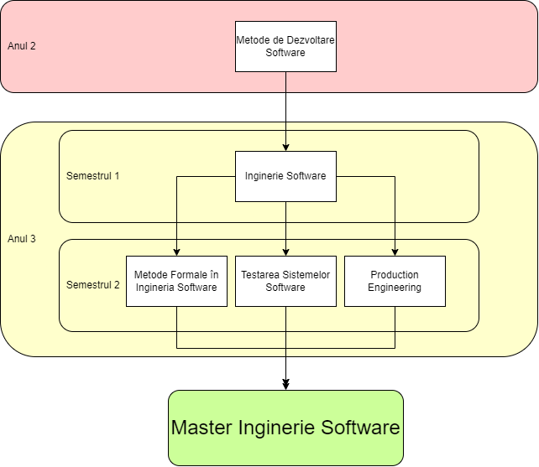
Software Engineering roadmap @ FMI

Slide 5
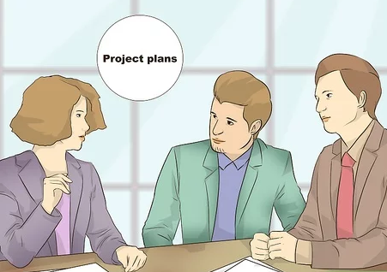
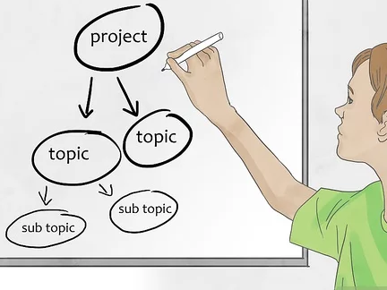
Project definition and characteristics
A project is defined as a specific, finite activity that produces an observable and measurable result under certain preset requirements. It is an attempt to implement desired change to an environment in a controlled way.

Slide 6
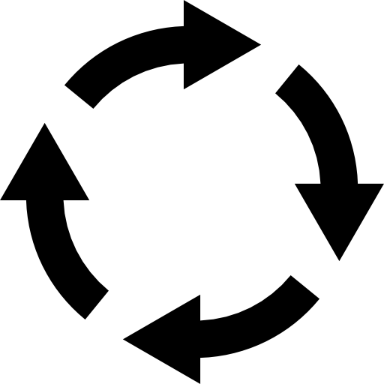




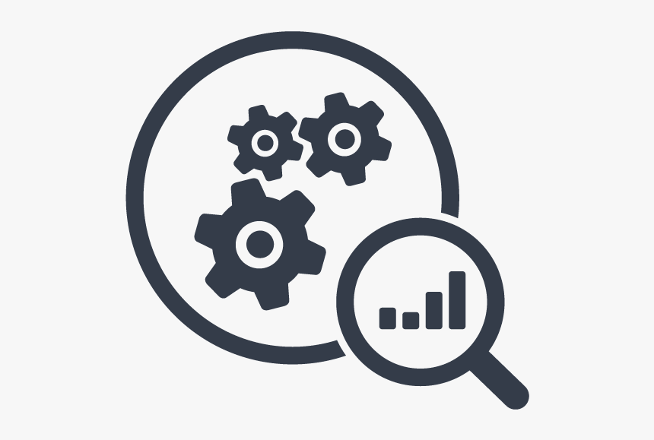
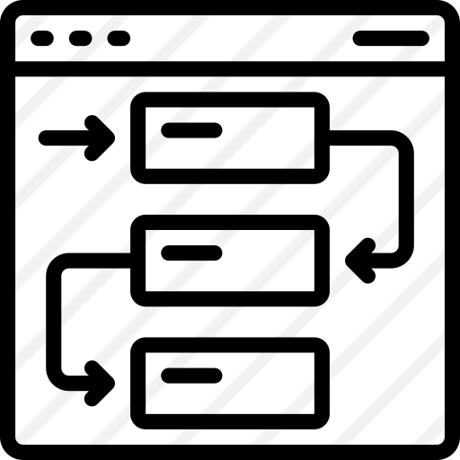
Project definition and characteristics
Lifecycle
A project is a set of tasks which must be completed in order to arrive at a particular goal or outcome.
Depending on the size and scope of the project, these tasks may be simple or elaborate, but all projects can be broken down into objectives and what needs to be done to achieve them.
According to the PMBOK® Guide—Fourth edition (PMI, 2008a, p. 434) the definition of a project is “a temporary endeavor undertaken to create a unique project service or result.”
Projects are temporary and close down on the completion of the work they were chartered to deliver.
Scope
Stakeholders
Deliverables
Milestones
Resources
Dependencies

Slide 7
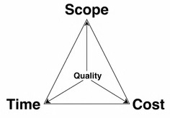
Project definition and characteristics
A single definable purpose, end-item or result. This is usually specified in terms of cost, schedule and performance requirements.
Every project is unique.
Projects are temporary in nature and have a definite beginning and ending date.
Projects are completed when the project goals are achieved or it's determined the project is no longer viable
A successful project is one that meets or exceeds the expectations of the stakeholders.
Every project has to manage four basic constraints:
Time
Cost
Scope
Quality

Slide 8
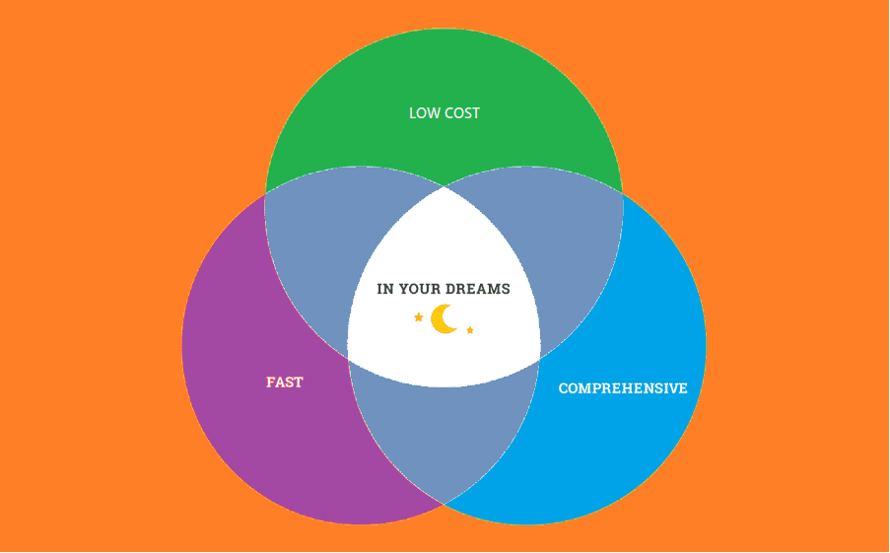
Project definition and characteristics

Slide 9
Example of projects and NOT a project
Example of projects:
Building a Light Rail Transit System: Building of the light-rail transit system to connect Bucharest city with Henry Coanda Airport.
Mobile App Development
3D Game Development: the team is working on a cool 3D game to be released this year on Oculus Rift. That is definitely a project with a strict deadline.
Building of Egypt's Pyramids: A remarkable achievement of a bygone era, that we marvel even today. These were some of the very first projects that we know of today.
Examples of non-projects:
Running the daily operations of a company
Doing regular maintenance work on the Light Rail Transit system that connects Bucharest city center to the main airport
Making breakfast everyday
Daily governance of the Kingdom of Egypt

Slide 10


Product definition and attributes
A product represents a collection of business capabilities valuable to a defined customer segment. A product may be just software and data.
A product is a good, service, platform, application, system, created, generally for sale, to meet customer and business needs.

Slide 11
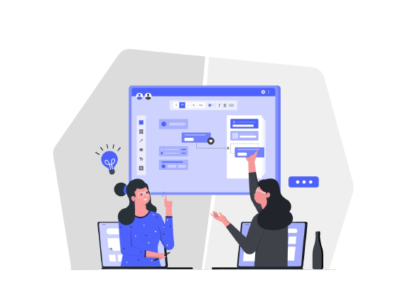
Product definition and attributes
A well-engineered software product should possess the following essential characteristics:
Efficiency
The software should not make wasteful use of system resources such as memory and processor cycles.
Maintainability
It should be possible to evolve the software to meet the changing requirements of customers.
Dependability
It is the flexibility of the software that ought to not cause any physical or economic injury within the event of system failure. It includes a range of characteristics such as reliability, security, and safety.
In time
Software should be developed well in time.
Within Budget
The software development costs should not overrun and it should be within the budgetary limit.
Functionality
The software system should exhibit the proper functionality, i.e. it should perform all the functions it is supposed to perform.
Adaptability
The software system should have the ability to get adapted to a reasonable extent with the changing requirements.

Slide 12
Product vs Project
Lifecycle
The product life cycle goes beyond a project life cycle.
Each product may have many projects associated to it during its life cycle.
PRODUCT | PROJECT
Facets of the product life cycle are often run as a project. | Occurs in one or more phases of the product life cycle. Ex: the retirement of a product can be a project on it’s own.
Longer lifetime | Defined lifetime
Adaptive roadmaps | Defined roadmaps [at high level scope]
Defined phases (development, introduction, growth, maturity, retirement) | Overlapping phases (initiation, planning, execution, monitoring and controlling, closure)

Slide 13
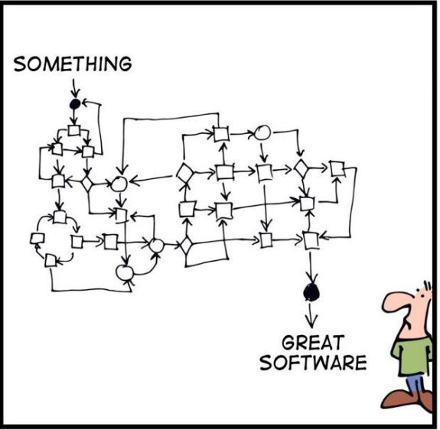
Software Development Lifecycle Overview
Software Development Life Cycle (SDLC) is a process used by the software industry to design, develop and test high quality software.
SDLC is a process followed for a software project, within a software organization.
It consists of a detailed plan describing how to develop, maintain, replace and alter or enhance specific software.

Slide 14
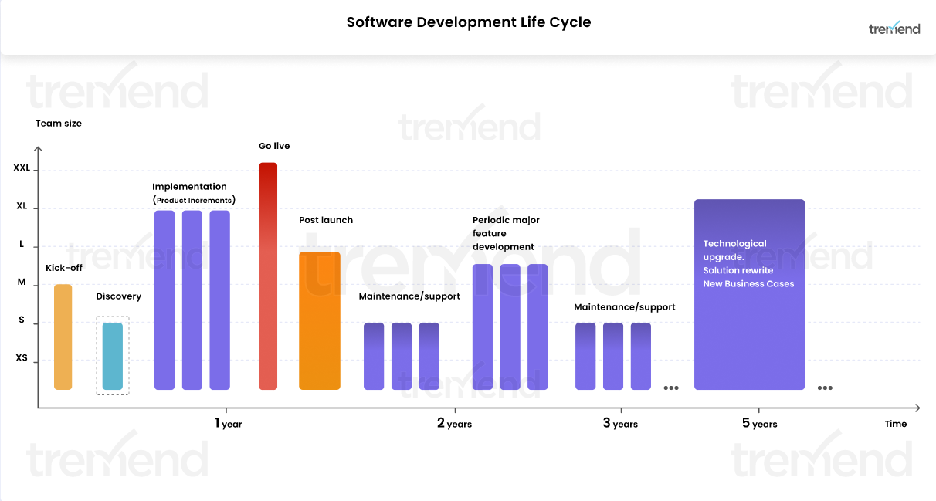
Software Development Lifecycle Overview

Slide 15
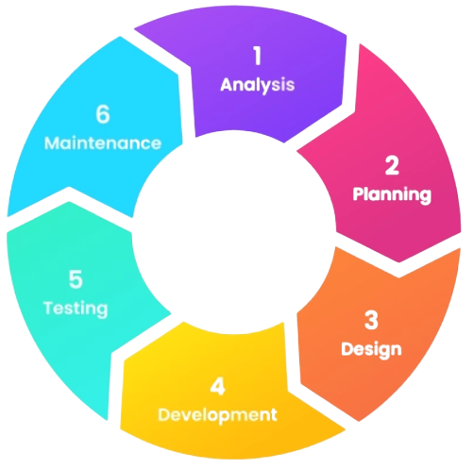
Software Development Lifecycle Overview
Stage 6: Maintenance
Stage 1: Analysis
During this software development lifecycle phase, the specialists meticulously collect precise requirements from the customer to present a solution fine-tuned to their needs. The analysis phase also gathers business requirements and identifies any potential risks.
The maintenance phase of the SDLC occurs after the product is in full operation. Maintenance of software can include software upgrades, repairs, and fixes of the software if it breaks.
Stage 5: Testing
Stage 2: Planning
The purpose of the second stage is to outline the scope of the problem and identify solutions. Resources, costs, time, and other aspects should be considered here. The planning phase of the SDLC is also when the project plan is developed that identifies, prioritizes, and assigns the tasks and resources required to build the structure for a project.
In the fifth stage, all the pieces of code are tested to verify and validate a software product. This is done to check the correspondence between the real and expected behavior of a requirement.
Stage 4: Development
Stage 3: Design
In the design phase, one or more designs are created to achieve the project result. Architecture of the software product is also defined in this phase.
The Development Phase includes several activities that are the responsibility of the developer. The developer places the outputs under configuration control, performs change control, documents and resolves problems and non-conformances found in the software products.
Notes:
De definit ce inseamna faza de analiza aici ca sa aiba sens sa fie prima

Slide 16
Organizare

Slide 17
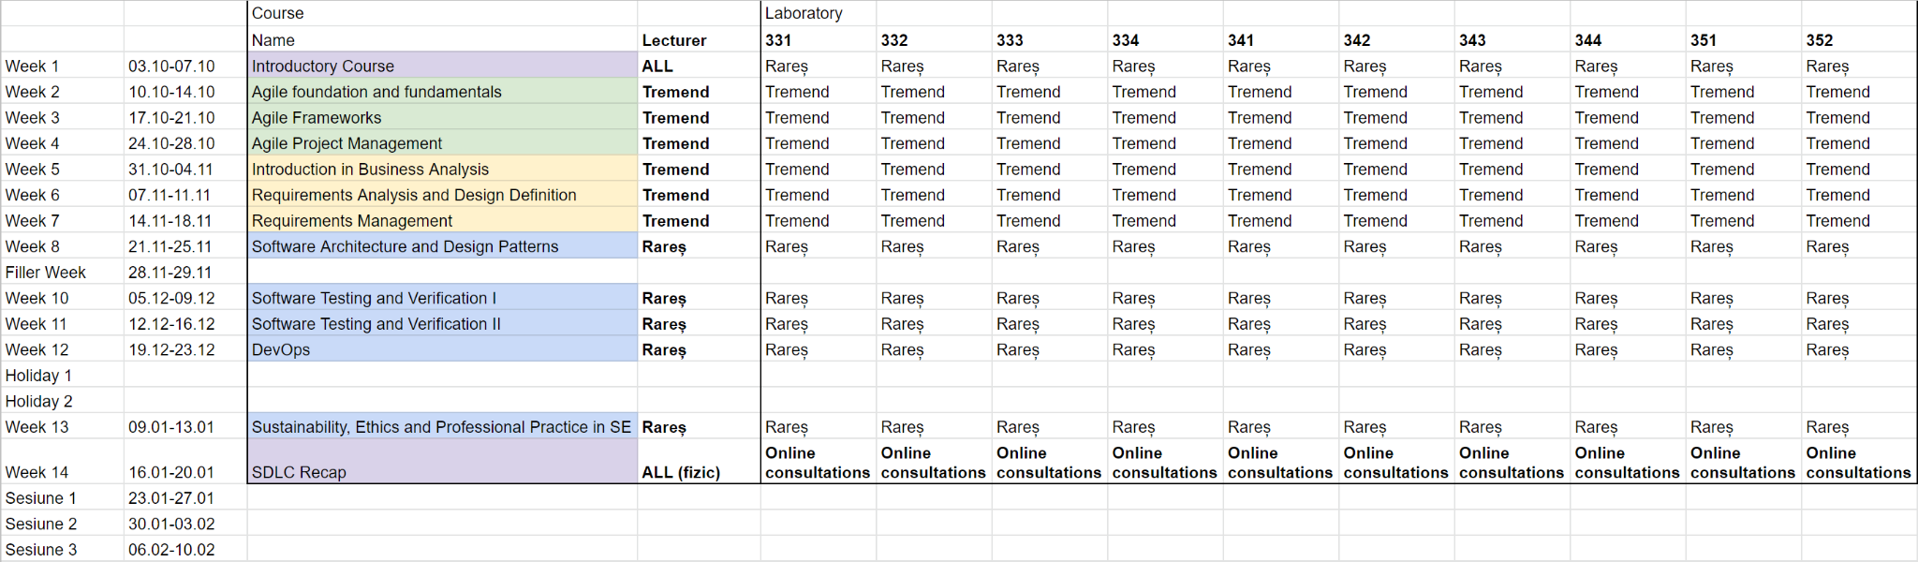
Organizarea cursului și laboratoarelor
Cursul are loc de două ori în fiecare săptămână, laboratorul este săptămânal pentru fiecare grupă.
De anunțat ce vom face în săptămâna 28-29.11 în funcție de orarul stabil.
De stabilit împreună prezentarea din sesiune după ce vă explic organizarea proiectului.

Slide 18
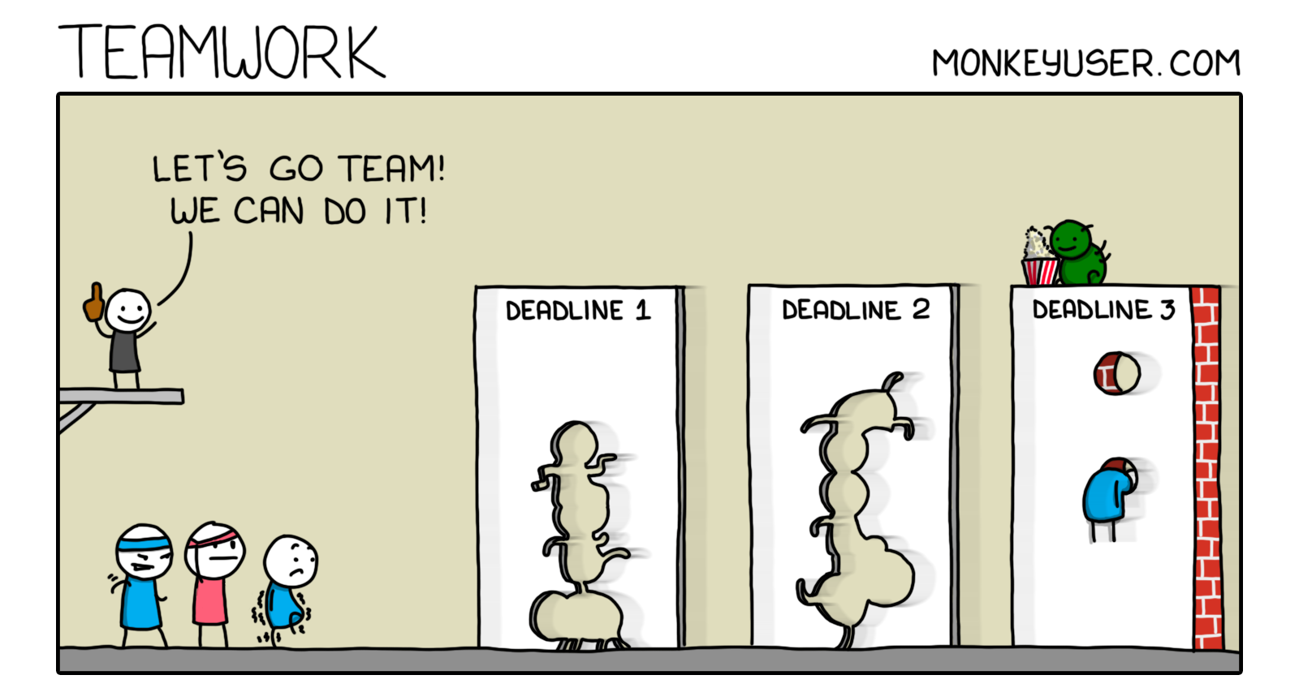
Organizarea proiectului
Examenul pentru Inginerie Software va consta în realizarea unui proiect software în echipă. Echipele vor fi formate din 4-6 studenți. Vă construiți singuri echipele. Membrii echipelor pot fi cross-grupe, și cross-serii.
Etapa 1
Team Formation - Pentru această etapă aveți 3 săptămâni de pe 03.10 până pe 21.10. Tot în această perioadă va trebui să vă alegeți o temă de proiect (care e subiectul proiectului vostru). Odată ce ați stabilit componența echipei, și tema proiectului, unul dintre membrii echipei va completa formularul: https://forms.office.com/r/9A5qbxfJyw

Slide 19
Organizarea proiectului
Etapa 2
Project Analysis - veți face setup-ul al proiectului (repoul de GitHub, tool-urile de dezvoltare, eventual să vă asigurați că puteți pe cât posibil să lucrați toți pe toate componentele proiectului).
Vom folosi și classroom.github.com dar pentru care va voi da linkul de join în săptămâna 2. Deci, vă rog nu creați un repo până atunci. De asemenea veți parcurge etapa de discovery al proiectului. Aceasta etapa este definita sub forma a doua sprinturi.
Livrabil intermediar - explicat pe slide-urile următoare Deadline: 29.11.2022 ora 12:00

Slide 20
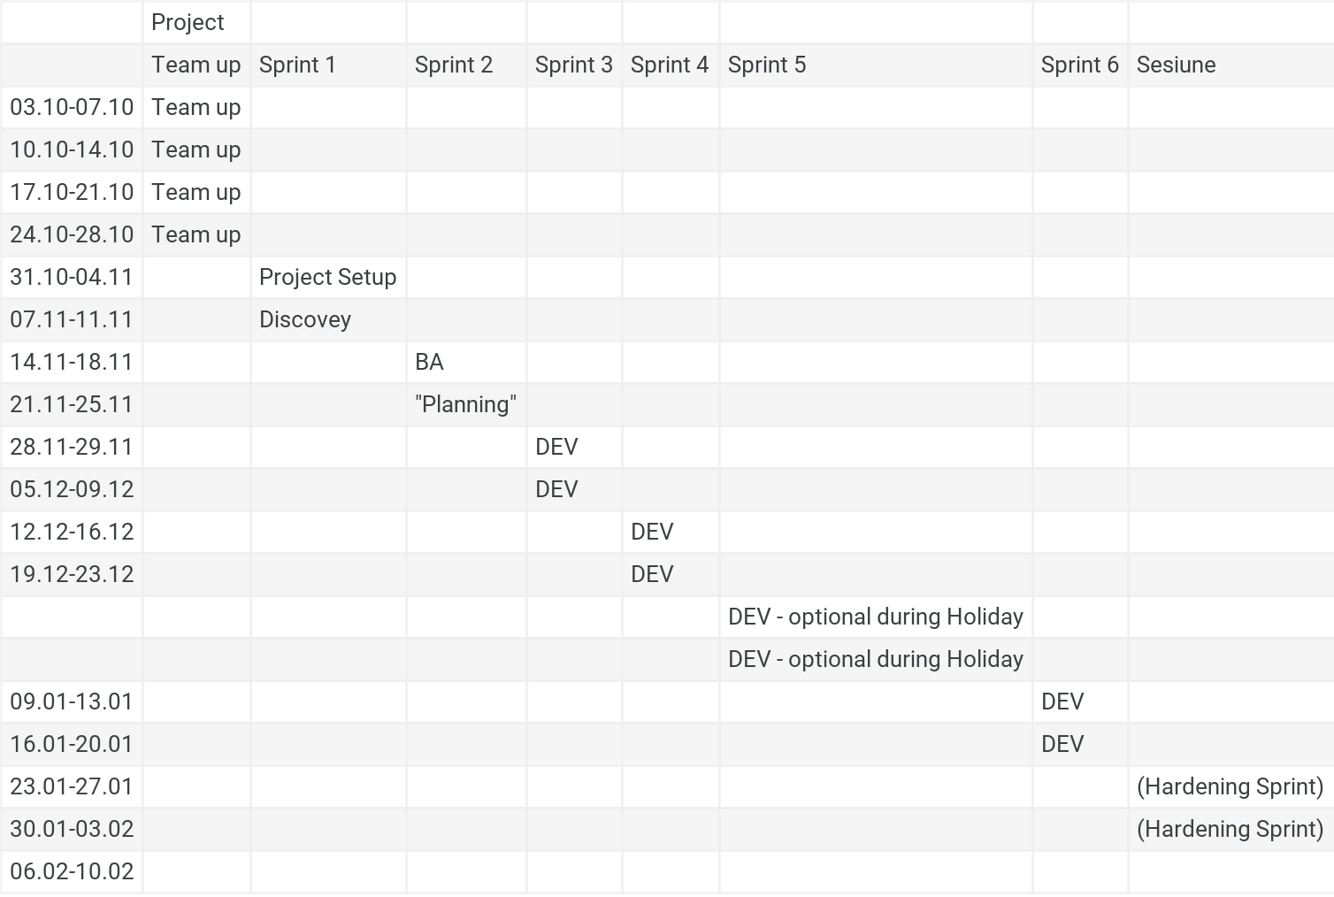
Organizarea proiectului
Etapa 3
Project Development - veți dezvolta aplicația propriu-zisă. Veți defini sprinturi de dezvoltare, în care veți distribui backlogul dezvoltat în etapa anterioară.
Vom evalua Sprint-ul 1 și 2 pentru toată lumea ca parte a livrabilului intermediar.
Dintre sprinturile de DEV(3-6), la final alegeți 3 cele mai „reușite” sprinturi ale voastre spre a fi evaluate.
Am definit sprintul 5 ca fiind opțional - la alegerea voastră dacă vreți să lucrați în vacanța de iarnă, dar dacă veți rezolva issue-uri în această perioadă, le veți asocia acestui sprint.
Pe timpul sesiunii în funcție de cum poziționăm examenul vom defini un Hardening Sprint.

Slide 21
Examen
Examenul va consta în evaluare proiectului pe care l-ați realizat
Livrabil Intermediar ( 40 puncte sub rezerva submiterii la timp a livrabilului ) Deadline: 29.11.2022 ora 12:00
Problem statement
Functional decomposition
Non-functional requirements list
1 Activity/State diagram
Prioritized product backlog (stories identified)
Project charter document: project objectives, scope, vision, team, and their responsibilities and stakeholders.
Roadmap: High level (epic/ feature level)
Definition of Done and Definition of ready: Story level and Sprint level

Slide 22
Examen
Proiectul final ( 60 puncte )
1 deliverable per sprint (select best 3 sprints):
sprint backlog (snapshot after planning),
Sprint report,
Retrospective outcome,
Review session (register application Demo)
User stories & acceptance criteria
Software Architecture report
Testare
Scalability testing (?)
User acceptance testing
Raport cu rezultatele acestor teste.
CI pipeline
Puteți face un demo offline cu rularea pipeline-ului și să adăugați linkul în Wiki-ul / README.md-ul proiectului
Prezentarea aplicației finale într-un demo live
Validarea funcționalității aplicației
Adresarea considerațiilor de etică și de sustenabilitate

Slide 23
Fastest growing tech company in Romania by Deloitte Fast 50
Course 1 - Introduction in Software Engineering
Q&A

